Slide 1
ARKANSAS RECYCLING COALITION
SEPTEMBER 19, 2017
Notes:
TED TALK CHAZ CHAT
HOW DO THE TRUMP PRESIDENCY, CHANGES TO THE EPA & THE NEW CONGRESS AFFECT THE RECYCLING INDUSTRY?

Slide 2
IT’S ALL ABOUT CHANGE
Notes:
WASTE & RECYCLING USED TO BE A NICE QUIET INDUSTRY PRETTY MUCH INSULATED FROM THE WINDS OF CHANGE
THIS HAS CHANGED DRAMATICALLY.
TODAY I WILL BE TALKING ABOUT CHANGE:
PRIMARILY CHANGES IN THE POLITICS OF WASTE
BUT ALSO CHANGES IN OUR RAW MATERIALS B/C THEY ALL HAVE POLITICAL IMPACTS IN RECYCLING & DIVERSION PROGRAMS
& CHANGES IN OUR THINKING ABOUT WHAT OUR GOALS SHOULD BE
BUT FIRST A CAVEAT ABOUT MY PREDICTIVE ABILITIES

Slide 3
MR. WIZARD
Notes:
THE CUBS DID WIN THE WORLD SERIES, BUT I WAS 32 YEARS AHEAD OF THE GAME
LET’S START W/THE POLITICS OF WASTE AT THE FEDERAL LEVEL

Slide 4
EPA
Notes:
THIS IS SCOTT PRUITT – EPA’S NEW ADMINISTRATOR
AS ADMINISTRATOR HE SETS THE TONE & IS THE PUBLIC FACE OF THE AGENCY
PRUITT HAS SAID HE WANTS TO CONCENTRATE ON “CORE FUNCTIONS”
HE HAS USED THE TERM “EPA ORIGINALISM” TO DESCRIBE HIS APPROACH
AN EMPHASIS ON CLEANING UP TOXIC WASTE & PROVIDING SAFE DRINKING WATER
HURRICANES HARVEY & IRMA ARE AN EARLY TEST OF THIS APPROACH
THE ADMINISTRATOR NORMALLY WORKS TO ACCOMPLISH HIS GOALS W/HIS “SENIOR STAFF” OF THE DEPUTY ADMINISTRATOR, THE ASSISTANT ADMINISTRATORS & THE REGIONAL ADMINISTRATORS
HOW ARE THOSE POLITICAL POSITIONS BEING FILLED?

Slide 5
POLITICAL STAFF
185+
12 require Senate hearing & approval
25 Schedule C
150 non-career political appointments
Notes:
12 EPA POSITIONS REQUIRE SENATE HEARINGS & CONFIRMATION
THIS INCLUDES THE ADMINISTRATOR, THE DEPUTY ADMINISTRATOR, THE ASSISTANT ADMINISTRATORS FOR EACH “OFFICE” SUCH AS AIR. LAND MANAGEMENT & A FEW OTHERS
24 ADDITIONAL EPA APPOINTMENTS ARE “SCHEDULE C” POLITICAL APPOINTMENTS
ANOTHER 150 ARE “NON CAREER” POLITICAL APPOINTMENTS (REGIONAL ADMINISTRATORS +) OR CAREER APPOINTMENTS
TOTALS 1.2% OF 15000+ EMPLOYEES
OLEM = 1 SENATE CONFIRMATION, 1 NON-CAREER & 9 CAREER APPOINTMENTS
HOW MANY OF THESE POLITICAL APPOINTMENTS HAVE BEEN FILLED?
FEBRUARY TOLD MOST OF THE AA’S & RA’S APPOINTEES WILL NOT BE IN PLACE UNTIL THE SUMMER/FALL
IT’S FALL
TRANSITIONS ALWAYS SLOW
THIS TRANSITION IS SLOWER THAN NORMAL

Slide 6
POLITICAL APPOINTEE STATUS
Only Administrator nominated & confirmed
AA for Enforcement awaited confirmation
September 20 hearing for four AAs
Schedule Cs in place
Career staff in acting capacity
Notes:
CURRENTLY ONLY THE ADMINISTRATOR HAS BEEN NOMINATED & CONFIRMED
THE AA FOR ENFORCEMENT – SUSAN BODINE – FORMER AA FOR SOLID WASTE
HAS BEEN NOMINATED, APPROVED BY EPW BUT NOT CONFIRMED BY FULL SENATE
SEPTEMBER 20 EPW HEARING FOR:
MICHAEL DOURSON: OFFICE OF CHEMICAL SAFETY & POLLUTION PREVENTION (TOSCA)
MATTHEW LEOPOLD: GENERAL COUNSEL
DAVID ROSS: WATER
WILLIAM WEHRUM: AIR & RADIATION
NO HEARING YET FOR DEPUTY ADMIN APPOINTMENT
ENVIRO RESPONSE: TILTED IN ONE DIRECTION
INDUSTRY HAS SAID THE SAME IN THE PAST
NO OLEM APPOINTMENT
SCHEDULE C’S – SEVERAL OF WHOM WERE CONGRESSIONAL STAFFERS – ARE IN PLACE
ALL THE UNFILLED POLITICAL POSITIONS ARE FILLED WITH CAREER STAFF IN ACTING CAPACITY
& W/POLTICALLY APPOINTED CONSULANTS/MINDERS
OLEM IS PATRICK DAVIS – RAN TRUMP CAMPAIGN IN COLORADO
NO DIFFERENT THAT PREVIOUS ADMINISTRATIONS: ALWAYS HAVE POLITICOS
WHAT ABOUT CAREER EMPLOYEES: THE OTHER 99 PERCENT?

Slide 7
CAREER STAFF
Buy-outs/RIFs
Low response to buy-outs
Notes:
$12 MILLION SET ASIDE FOR BUY-OUTS, EARLY RETIREMENTS & RIFS
BUY-OUTS & EARLY RETIREMENTS NOT WELL RECEIVED
ONLY ABOUT 300 OR 400 HUNDRED OUT OF ANTICIPATED 1000+
RIFS YET TO COME
NOTE: THIS IS NOT NEW:
OBAMA ADMINISTRATION DID ITS OWN SET OF BUY-OUTS & EARLY RETIREMENTS
MONEY TALKS: LET’S LOOK AT THE PROPOSED BUDGET & SEE WHAT IT SAYS ABOUT PRIORITIES

Slide 8
EPA BUDGET (PROPOSED)
“Core” functions
Shift to states
Waste management cut
Waste minimization & recycling eliminated
Enforcement cut
Notes:
PROPOSED ADMINISTRATION BUDGET CALLED FOR 31% REDUCTION IN EPA BUDGET & 21% REDUCTION IN WORK FORCE
WASTE MANAGEMENT REDUCED BY 10%: $1.5 MILLION + 120 FTES
“PRIORITIZE RESOURCES ON THE FEDERAL PCB CLEANUP & DISPOSAL PROGRAM”
“SUPPORT STATES & TRIBES IN IMPLEMENTING THEIR OWN PROGRAMS”
WASTE MINIMIZATION & RECYCLING ELIMINATED
$1.9 MILLION – 51 FTEs – 16 HQ, 35 REGIONS
“STATE & LOCAL ENTITIES OR INDUSTRY GROUPS MAY ELECT TO CONTINUE WORK TO REUSE & RECYCLE MATERIALS”
SUPERFUND IS A CORE FUNCTION BUT ITS BUDGET REDUCED
ENFORCEMENT CUT W/AN EMPHASIS ON
FOCUSING ON ENFORCEMENT AREAS THAT ARE NOT DELEGATED TO STATES
SUPPORTING STATES & TRIBES AS THE PRIMARY ENFORCERS OF ENVIRONMENTAL LAWS
& PROVIDING NATIONAL CONSISTENCY
NOTE: EPA’S BUDGET DECLINED UNDER OBAMA
FLAT IN REAL DOLLARS SINCE 1990
ADMINISTRATION PROPOSES
CONGRESS DISPOSES
WHAT HAS CONGRESS DONE?

Slide 9
EPA BUDGET (HOUSE)
Kept waste & recycling programs
No final budget
Notes:
HOUSE REDUCED EPA BUDGET BY ONLY $545 MILLION
HOUSE APPROPRIATIONS COMMITTEE REJECTED SLASHES TO SOLID WASTE BUDGET
COMMITTEE CHAIR IS FROM NEW JERSEY
A STATE WITH ITS FAIR SHARE OF SUPERFUND SITES
ONE OF THE STRONGEST STATEWIDE RECYCLING PROGRAMS IN THE COUNTRY
LOCAL PRESSURE TO PRESERVE FUNDING FOR WASTE & RECYCLING (& SUPERFUND)
STILL NO FINAL BUDGET
PUTTING ON MY CUBS T-SHIRT I REFUSE TO GUESS WHEN!
NOTE: THIS IS EPA’S SIXTH CHANGE OF ADMINISTRATIONS SINCE ITS CREATION
THE REAL CRUNCH WILL COME WITH THE NEW BUDGET
CURRENTLY EPA IS STILL OPERATING ON ITS LAST BUDGET
BUT THINK ABOUT THIS FOR A MOMENT

Slide 10
WASTE & RECYCLING LAWS: NATIONAL
Resource Conservation and Recovery Act (RCRA)
Barely mentions recycling
State not federal responsibility
Notes:
AT THE NATIONAL LEVEL, THE RESOURCE CONSERVATION & RECOVERY ACT IS CLEAR:
THAT STATES & LOCAL GOVERNMENTS ARE RESPONSIBLE FOR SOLID WASTE & RECYCLING
NOT THE FEDERAL GOVERNMENT.
RCRA PASSED BY CONGRESS IN 1976.
SUBTITLE C HAZARDOUS WASTE REGULATORY PROGRAM
SUBTITLE D SOLID WASTE PROGRAM INCLUDING LANDFILL GUIDELINES
BARELY MENTIONS RECYCLING
VISION OF RESOURCE CONSERVATION W/LITTLE ACTUAL ASSIGNED RESPONSIBILITIES
SINCE 1976 CONGRESS HAS SHOWN LITTLE INTEREST IN RECYCLING OR SOLID WASTE.
ONLY EXCEPTION DURING THE PACKAGING WARS OF THE EARLY 90’S
EPA REBUILT ITS RECYCLING PROGRAM IN THE 90’S
& HAS HAD A SOLID PROGRAM SINCE THEN
BUT IT IS INHERENTLY VULNERABLE WHEN TIMES ARE TIGHT & LITTLE IF ANY POLITICAL PRESSURE EXISTS TO PROTECT IT
SO WHAT ARE THE INDUSTRY PRIORITIES FOR THE NEW EPA SINCE NOT LISTED AS A CORE FUNCTION?

Slide 11
EPA ISSUES
Enforcement policy
Deregulation?
Landfill gas
Greenhouse gas inventory
WARM model
MSW data
Notes:
ENFORCEMENT POLICY WILL BE CRUCIAL
INDUSTRY BUILT ON REGULATION & FAIR & EQUAL ENFORCEMENT OF THE LAW
DEREGULATION?
SUBTITLE D REGS NOT CONTROVERSIAL EXCEPT LANDFILL METHANE
SUBTITLE C REGS NOT HIGH PRIORITY
CHANGES TO AIR & WATER REGS (CLEAN POWER, WOTUS, ETC) WILL BE POLITICALLY CONTENTIOUS
WOTUS SWALES, HOLDING PONDS ETC.
FR NOTICE @ POTENTIAL REVISIONS: 30K+ RESPONSES
LANDFILL GAS EMISSIONS
LAWSUIT ALONG W/SWANA
WORKING W/EPA ON REVISED EMISSIONS GUIDELINES/NEW SOURCE PERFORMANCE STANDARDS FOR LANDFILL METHANE EMISSIONS
REVERSE CONTRADICTORY SECTIONS
SENT LETTERS IN SUPPORT OF CONTINUING
THE GREENHOUSE GAS EMISSION INVENTORY
THE WARM MODEL
MSW DATA
WHAT ABOUT INDUSTRY PRIORITIES ON THE HILL?

Slide 12
FEDERAL PRIORITIES
Infrastructure spending
Job training
Tax reform/tax credits for CNG & landfill gas
Causation
Notes:
INFRASTRUCTURE SPENDING:
WE ARE A TRUCKING INDUSTRY
ALL THAT C&D
JOB TRAINING
NO SECRET FINDING QUALIFIED PEOPLE – ESPECIALLY DRIVERS & MECHANICS – IS TOUGH
PERKINS ACT VOCATIONAL TRAINING GRANTS
TAX REFORM:
TRY TO REVIVE THE TAX CREDITS FOR CNG & LANDFILL GAS
OR GOOD TRADEOFF DURING LEGISLATIVE TAX REFORM DEBATE
GAS TAX: PREZ SUPPORT INCR BUT TRADEOFF ELIMINATE THE EXCISE TAX ON TRUCKS
NWRA WILL ALSO FOCUS ON LEGISLATIVE OR REGULATORY CHANGES THAT WILL REQUIRE CAUSATION TO BE PROVEN WHEN COMPANIES & DRIVERS ARE CHARGED W/A FATALITY UNDER THE CSA PROGRAM FOR COMMERCIAL MOTOR VEHICLES
ANOTHER FEDERAL ISSUE RECENTLY AROSE

Slide 13
NATIONAL SWORD
New Chinese restrictions on recycling imports
Recycler pushback
Notes:
NEWLY ANNOUNCED CHINESE RESTRICTIONS ON IMPORTS OF RECYCLABLES HAVE KICKED UP A STORM
THEORETICAL ALLOWANCE OF ONLY 0.3% “CONTAMINATION” IN A BALE
PUSHBACK FROM RECYCLING INDUSTRY (INCLUDING CHINESE)
MEETINGS WITH DEPARTMENT OF CONGRESS & U.S. TRADE REP’S OFFICE
WHAT DO WE WANT?
CLARITY IN WHAT IS ACCEPTED & RESTRICTED
REALISTIC STANDARDS (NOT 0.3%)
MORE TIME TO ADJUST
STATUS OF IN-COUNTRY INSPECTIONS
END UNCERTAINTY
WHAT ABOUT CLIMATE CHANGE?

Slide 14
CLIMATE CHANGE
Notes:
CLIMATE CHANGE:
ANYTHING CLIMATE CHANGE RELATED WILL BE SUBJECT TO REVIEW
AS I NOTED EARLIER, NWRA SUPPORTS KEEPING THE GREENHOUSE GAS INVENTORY, THE WARM MODEL & EPA’S FACTS & FIGURES ON MSW
BUT IF WASTE MINIMIZATION & RECYCLING ARE ZEROED OUT:
WHO WILL MAINTAIN THE WARM MODEL
WHAT NEW DATA BASE WILL HAVE EPA’S SPECIFICITY ON MATERIALS IN THE WASTE STREAM
WHAT WILL HAPPEN TO FOOD WASTE EFFORTS & SUSTAINABLE MATERIALS MANAGEMENT?
THE WARM MODEL IS STILL AVAILABLE ON THE EPA WEB SITE
THE LINK ON THAT PAGE TO “CLIMATE CHANGE”

Slide 15
EPA & CLIMATE CHANGE
This page is being updated.
Thank you for your interest in this topic. We are currently updating our website to reflect EPA's priorities under the leadership of President Trump and Administrator Pruitt. If you're looking for an archived version of this page, you can find it on the January 19 snapshot.
Notes:
AS OF SEPTEMBER 6 THIS IS WHAT YOU WOULD SEE
ODDLY THE LINKS TO THE ARCHIVED PAGES STILL WORK
HOW ARE WASTE & RECYCLING PLAYING OUT IN THE STATES?

Slide 16
2017 STATE LEGISLATIVE PRIORITIES
Obamacare
Financial stress
Immigration
Zika
Infrastructure spending
Policing
Marijuana
Opiods
Clean energy
Social issues
School choice
Foster care
Higher education
Notes:
THESE ARE THE BIGGEST POLICIES & PROBLEMS FACING STATE LEGISLATURES IN 2017 ACCORDING TO GOVERNING MAGAZINE
ARGUABLY 3 OF THESE (ZIKA, INFRASTRUCTURE SPENDING & CLEAN ENERGY) HAVE ENVIRONMENTAL IMPLICATIONS
NO MENTION OF SOLID WASTE OR RECYCLING
NUMBER OF WASTE/RECYCLING-RELATED BILLS AT THE STATE LEVEL HAS BEEN STATIC FROM 2006 TO 2016. WHY?
WE ARE THE VICTIMS OF OUR SUCCESS
NO HORROR STORIES
LITTLE PRESS INTEREST
FEELING THAT PROBLEMS EITHER RESOLVED OR UNDER CONTROL OR STATES SIMPLY HAVE BIGGER PRIORITIES
ONLY EXCEPTIONS

Slide 17
STATE PRIORITIES WASTE & RECYCLING
Slow down/worker safety
Routine fixes
Food waste
Fix e-scrap recycling laws
Notes:
DRIVER/WORKER SAFETY
SLOW DOWN LAWS
FOOD WASTE LEGISLATION IN STATES W/HIGH TIPPING FEES OR LIMITED DISPOSAL CAPACITY
ELECTRONICS RECYCLING LAWS ARE OUT OF DATE & NEED TO BE UPGRADED
DIFFERENT, LIGHTER WEIGHT PRODUCTS

Slide 18
IT’S ALL ABOUT CHANGE
Politics of waste
Our raw material
Sustainable materials management
Notes:
LET’S GET AWAY FROM POLITICS FOR A WHILE
HARD TO DO FOR AN INDUSTRY THAT IS SO MUCH ABOUT POLITICS – ESPECIALLY AT THE LOCAL LEVEL
LET’S LOOK AT CHANGES THAT ARE NOT POLITICALLY INSPIRED
OUR RAW MATERIALS
THESE CHANGES ARE NOT POLITICALLY INSPIRED:
BUT THEY HAVE IMPACTS ON WHAT WE RECYCLE
ON OUR ABILITY TO MEET RECYCLING GOALS
ON HOW WE SHOULD MEASURE SUCCESS
SO CLEARLY THEY WILL HAVE A POLITICAL IMPACT
BUT FIRST SOME QUICK DATA

Slide 19
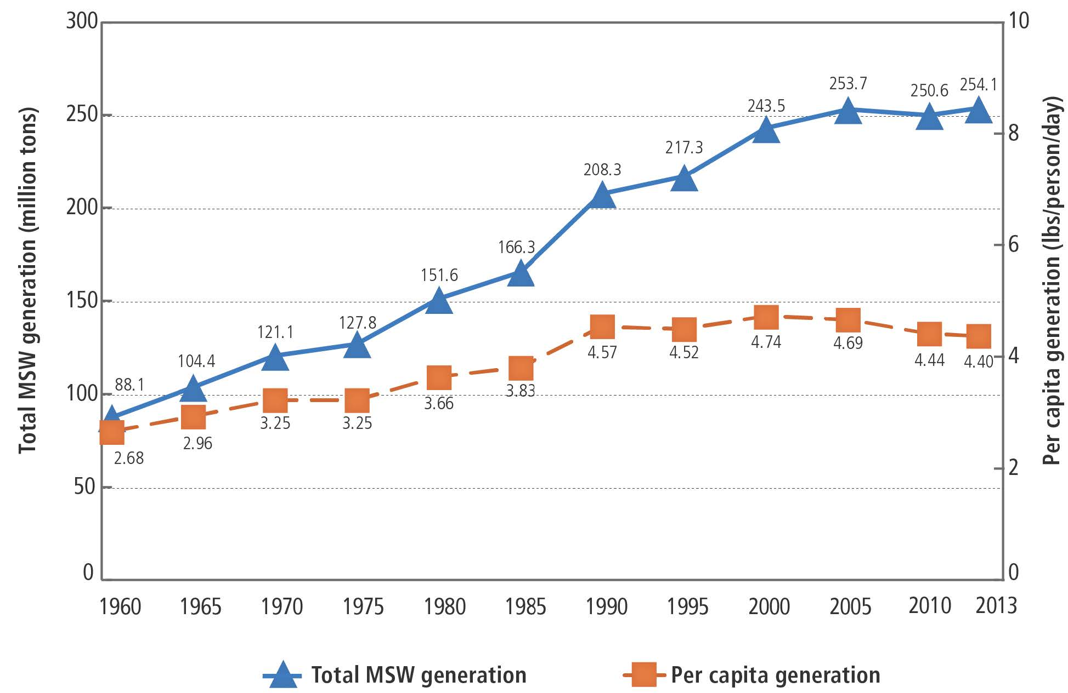
MSW GENERATION RATES
Notes:
GROWTH IN SOLID WASTE GENERATION FLAT SINCE 2000
POPULATION GREW AT TWICE THE RATE OF GARBAGE 2000 – 2014
PER PERSON DOWN BY .3 POUNDS PER DAY OR 6.4%
WHY ISN’T ANYONE COMPLAINING THAT GARBAGE GENERATION IS STAGNANT?
HOW DO WE MANAGE THEM?

Slide 20
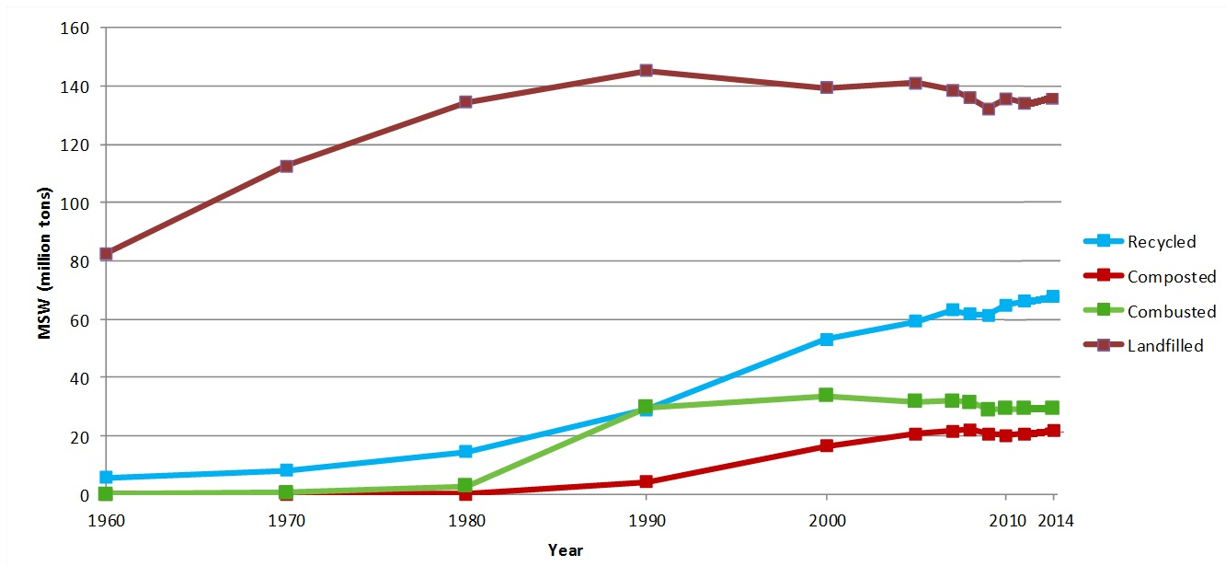
MANAGEMENT TRENDS
Notes:
THIS IS HOW WE MANAGE THEM
THIS IS EPA DATA: 1960 – 2013 TOTAL AMOUNT OF MSW WE GENERATED BEFORE RECYCLING & COMPOSTING
(NOTE ALL DATA EPA)
DISPOSAL WHETHER LANDFILLING OR ENERGY FROM WASTE PEAKED IN 1990
SLOW DECLINE SINCE
RECYCLING & COMPOSTING BOTH ROSE DRAMATICALLY
RECOVERY TONNAGE INCREASED BY 161%
RECOVERY RATE INCREASED BY 107%
WHAT ABOUT OUR RAW MATERIALS?

Slide 21
RAW MATERIAL TRENDS
Less garbage/recyclables
Different garbage/recyclables
Notes:
THIS HAS BEEN THE BIGGEST STORY OF WASTE & RECYCLING SINCE 2000 (OR EARLIER)
CAUSING CHALLENGING OPERATIONAL & REVENUE ISSUES AT MRFS & IMPACT ON LANDFILLS
PRINTED PAPER DOWN 20 MILLION TONS IN GENERATION
NEWSPAPER PEAKED 2002
OFFICE PAPER 2007 (SO DID CATALOGS & DIRECT MAIL)
PACKAGES? LIGHTWEIGHTING INTENSE
WATER BOTTLE 37% REDUCTION IN A DECADE
LETS LOOK AT THE LEAST KNOWN TREND OF THIS MILLENIUM

Slide 22
PACKAGING PLATEAU
2000: 75.9 million tons of packaging
2014: 76.7 million tons of packaging
Total increase: 840,000 tons
2000: 539 pounds per person
2014: 481 pounds per person
Per person decrease: 58 pounds
Notes:
MOST INTRIGUING TREND OF THE LAST 14 YEARS
TOTAL PACKAGING: 840,000 TON GROWTH 2000 TO 2014
1% GROWTH
EPA DATA: ALL CONTAINER AND PACKAGING PRODUCTS (PG 29 ADVANCING SUSTAINABLE MATERIALS MANAGEMENT: 2014 TABLES AND FIGURES DECEMBER 2016)
EXCLUDE WOOD PACKAGING AND PACKAGING DECLINED BY 200,000 TONS
PER CAPITA: 58 POUND DECLINE
10 PERCENT LOSS
CAN ANY EUROPEAN COUNTRY OR CANADIAN PROVICES BOAST SIMILAR SUCCESS?
ALL ABOUT MARKET FORCES, COMPETITION AND FREE ENTERPRISE
WHY PUNISH SUCCESS?
ONE MAJOR REASON IN ADDITION TO NORMAL LIGHT WEIGHTING?
NOTE: 2000 76,330 tons, US population 281,400,000
2014 76,670 tons, US population 318,900,000
2000: 539.019 pounds per person
2014 480.840 pounds per person

Slide 23
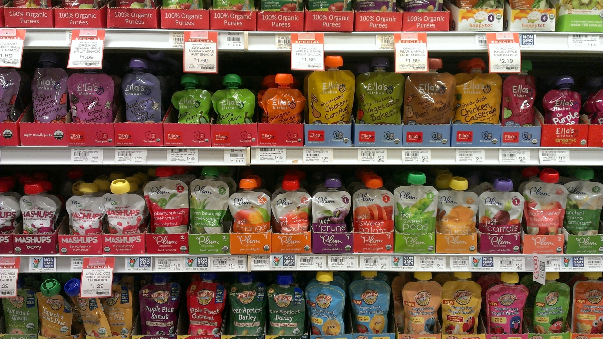
FLEXIBLE PACKAGING
Notes:
FLEXIBLE PACKAGING: THE FASTEST GROWING PACKAGE
18% OF THE PACKAGING MARKET (CORR 23%, RIGID PLASTICS 16%, METAL CANS 13%, PAPERBOARD 12%, GLASS 4%, OTHER 14%)
FLEXIBLE PACKAGING HAS NO SHAPE OF ITS OWN
MOSTLY PLASTIC (69%) BUT CAN INCLUDE PAPER (15%) FOIL (4%) & ADHESIVES, COATINGS & INKS (12%)
TECHNOLOGICALLY ADVANCED
MULTI-LAYER & MULTI-RESIN
BARRIER LAYERS & TIE LAYERS
TREMENDOUS ENERGY & ENVIRONMENTAL SAVINGS UPSTREAM & DOWN
CAN’T BE RECYCLED
BUT HOW MUCH WASTE HAVE THEY AVOIDED IN THE ECOSYTEM IN SPITE OF THEIR LACK OF RECYCLABILITY?
IS RECYCLING OUR SACRED COW?

Slide 24
LESS WASTE/DIFFERENT WASTE TRENDS
Zero waste by industry
Source reduction
Have we hit the wall?
Notes:
INDUSTRY INTENSE ADOPTION OF ZERO WASTE STRATEGIES THAT EMPHASIZE USING LESS MATERIALS TO MAKE MORE PRODUCTS & DIVERTING “WASTE” TO RECYCLING OR ORGANICS RECOVERY
SIMILAR SUCCESS STORIES FOR LIGHTWEIGHTING
BUT HAVE WE HIT THE WALL?
FAR FEWER INDUSTRY ZERO WASTE EXAMPLES IN 2015 & 2016
IN ADDITION, SUSTAINABILITY EFFORTS IN CORPORATIONS APPEAR TO BE SLOWING DOWN
HAVE THE ACHIEVABLE, VALUE-ADDED TARGETS BEEN HIT?
LIMITS TO LIGHTWEIGHTING: PACKAGE MUST STILL CONTAIN THE PRODUCT
WATERBOTTLES COLLAPSING AT THE NECK
WALMART’S NEW SUSTAINABLE PACKAGING PRIORITIES:
SOURCE SUSTAINABILITY INCLUDING RECYCLED CONTENT BUT
PROTECT THE PRODUCT WHILE REDUCING PACKAGING
FUTURE MATERIAL TRENDS

Slide 25
E-COMMERCE
8.5% retail sales in 2016
X% in 2020? 2025?
Corrugated boxes
Flexible/film wrap
Notes:
E-COMMERCE HAS BEEN THE SAVIOR OF THE PAPER PACKAGING INDUSTRY
E-COMMERCE POSITIVE FOR CORRUGATED BOXES
SALES ARE PROJECTED TO INCREASE
GREAT FOR RECYCLING
ALL OF THAT HIGHER VALUE BROWN FIBER
ONE CAVEAT: WILL FLEXIBLE OPTIONS STEAL AWAY CORRUGATED BOX MARKETS?
LOOKING FURTHER OUT, WHAT IS LIKELY TO CHANGE OUR RAW MATERIALS

Slide 26
DRONES
Notes:
PHOTO WASHINGTON POST
CAN ALREADY BE USED AT LANDFILLS FOR A VARIETY OF PURPOSES
E-COMMERCE & RETAILERS LOOKING AT AS DELIVERY OPTION
REGULATORY & LEGAL HURDLES REMAIN
VEGAS AREA VIDEO OF PACKAGE DELIVERY
IMPACT ON PACKAGING NEEDS?
STURDIER FOR FLIGHT INCLUDING LANDING?
FAA now allows carriage of cargo
No HAZMAT
Max weight of loaded vehicle can't exceed 55 lbs

Slide 27
3-D PRINTING
Notes:
DID I MENTION 3-D PRINTING?

Slide 28
INTERNET OF THINGS
Notes:
OR THE INTERNET OF THINGS?
CLOTHES
ELECTRONICS
MY POINT IS THIS: AS TECHNOLOGY EVOLVES, OUR RAW MATERIALS EVOLVE
WE ARE A REACTIVE INDUSTRY
WE HAVE TO EVOLVE AS OUR RAW MATERIALS EVOLVE
SO DO THE POLITICS OF WASTE
LET’S GET MORE DOWN TO EARTH & LOOK AT ORGANICS

Slide 29
ORGANICS
Notes:
INTEREST IN ORGANICS SKYROCKETED B/C IT IS THE NEW FRONTIER FOR RECOVERY
YARD WASTE IS WELL ESTABLISHED & “EASY”:
WE SOURCE REDUCE @ 10 – 15 MILLION TONS THROUGH GRASSCYCLING & BACKYARD COMPOSTING
WE COMPOST 4.25 MT OF YARD WASTE
MORE THAN HALF OF WHAT GETS TO THE CURB
25 STATES BAN YARD WASTE DISPOSAL
FOOD WASTE IS THE NEW KID ON THE BLOCK & IT IS NOT EASY
FACES SIGNIFICANT CHALLENGES IN REGARD TO CONTAMINATION, COLLECTION, PROCESSING, SITING FACILITIES & HUMAN BEHAVIOR OBSTACLES
BUT INCREASED ORGANICS RECOVERY IS THE KEY TO A HIGHER RECYCLING RATE
ALMOST 200 RESIDENTIAL COLLECTION
COMMERCIAL COLLECTION: INCREASINGLY PROMINENT
SIX STATES (CONNECTICUT, VERMONT, MASSACHUSETTS, RHODE ISLAND, CALIFORNIA & MINNESOTA) BAN DISPOSAL OR OTHERWISE REQUIRE SOME LEVEL OF FOOD WASTE RECOVERY + NEW JERSEY
THE MOST SUCCESS IS LIKELY TO COME FROM ZERO WASTE TYPE OPTIONS

Slide 30
ORGANICS
Notes:
THIS POSTER IS USED IN A BRITISH FOOD WASTE REDUCTION CAMPAIGN: LUSCIOUS ISN’T IT?
EDIBLE FOOD: FEEDING AMERICA:
2,000,000 MILLION TONS IN 2013 TO FEED THE HUNGRY
530,000 TONS DIVERTED BY RETAILERS BEFORE EXPIRATION DATE
CALORIC CONTENT FROM BAKERY STARCHES TO DAIRY, PRODUCE & MEAT
ANIMAL FEED:
15 MT MFR (FWRA STUDY) + 5 MT LAND APP
2.7 MILLION TONS SPENT BREWERS GRAINS
IN-FACILITY OPERATIONS
GRIND2ENERGY & OTHER OPTIONS TO CREATE SLURRY OR PET FOOD OR WHAT HAVE YOU
BETTER LABELLING ON FOOD PRODUCTS
GMA FMI “BEST IF USED BY” (TASTE) & “USE BY” (HEALTH)
IMPORTANT FIRST STEP & ALLOWS US TO BUILD INFRASTRUCTURE
& WILL HAVE SAME ZERO WASTE IMPACTS AS WE HAVE SEEN IN INDUSTRY
TO GET BACK TO POLITICS FOR A MOMENT
WILL EITHER EPA OR THE DEPARTENT OF AGRICULTURE CONTINUE THEIR EFFORTS TO MINIMIZE FOOD WASTE?

Slide 31
IT’S ALL ABOUT CHANGE
Politics of waste
Our raw material
Sustainable Materials Management
Notes:
I WANT TO FINISH W/A QUICK LOOK AT WHAT I THINK IS THE MOST EXCITING TREND IN HOW WE THINK ABOUT MANAGING OUR WASTE
& ONE THAT REQUIRES CHANGES TO STATE LAW

Slide 32
A NEW WAY OF THINKING
Notes:
EPA LAUNCHED ITS THINKING ON THIS ISSUE IN 2009 W/THE PUBLICATION OF SUSTAINABLE MATERIALS MANAGEMENT: THE ROAD AHEAD
https://www.epa.gov/smm/sustainable-materials-management-road-ahead
WRITTEN UNDER BUSH2 RELEASED UNDER OBAMA
WHAT IS SUSTAINABLE MATERIALS MANAGEMENT?

Slide 33
SUSTAINABLE MATERIALS MANAGEMENT
“Sustainable materials management is a systemic approach to using and reusing materials more productively over their entire lifecycles. It represents a change in how our society thinks about the use of natural resources and environmental protection. By looking at a product's entire lifecycle we can find new opportunities to reduce environmental impacts, conserve resources, and reduce costs.”
Notes:
EPA DEFINITION OF MM (FROM OPPORTUNITIES TO REDUCE GREENHOUSE GAS EMISSIONS THROUGH MATERIALS & LAND MANAGEMENT PRACTICES).
Use materials in the most productive way with an emphasis on using less;
Reduce toxic chemicals and environmental impacts throughout the material life cycle;
Assure we have sufficient resources to meet today’s needs and those of the future
LIFE CYCLE IS THE KEY
WHAT IS THE BIGGEST ENVIRONMENTAL BENEFIT FROM BEGINNING TO END
THIS RAISES SOME KEY QUESTIONS

Slide 34
SUSTAINABLE MATERIALS MANAGEMENT
Is recycling the ultimate goal?
or
Less overall waste in the ecosystem?
Hierarchy?
Notes:
IS 100% RECYCLING & COMPOSTING THE ULTIMATE GOAL?
END OF THE PIPELINE WASTE MANAGEMENT VIA INCREASED RECYCLING & COMPOSTING
OR
LESS OVERALL WASTE IN THE ECOSYSTEM ?
LOWERING THE EXTRACTION OF RAW MATERIALS & ENERGY USED IN MANUFACTURING & TRANSPORTATION
EVEN THOUGH SOME OF THOSE PRODUCTS CANNOT BE RECYCLED & MUST BE DISPOSED?
SUSTAINABLE MATERIALS MANAGEMENT IS FUNDAMENTALLY ANTI-HIERARCHICAL ALTHOUGH IT DOES HAVE PREFERENCES
BOTTOM LINE IS SIMPLE: LESS IMPACT ON THE ENVIRONMENT & LET THE CHIPS FALL WHERE THEY MAY
MEASURE SUCCESS BY GREENHOUSE GAS EMISSION REDUCTIONS
SUMMARY

Slide 35
SUMMARY
EPA core functions include solid waste?
Budget still unresolved
Less/different waste
Disposal needed for a long time
Need to think sustainably
Interesting times!

Slide 36
FOR MORE INFORMATION:
Chaz Miller
202-364-3742 www.wasterecycling.org cmiller@wasterecycling.org
Notes:
THANK YOU

